Slide 1
“Man-Made Climate Change in the Skies” Or Playing God with the Atmosphere and Earth Commonwealth Club Panel Discussion, 3/28/11
Dr. Eric Karlstrom
Professor of Physical and Environmental Geography
California State University, Stanislaus

Slide 2
Michael Crichton, 2003, “Environmentalism as Religion,” speech at Commonwealth Club
“The greatest challenge facing mankind is the challenge of distinguishing reality from fantasy, truth from propaganda. We must daily decide whether the threats we face are real, whether the solutions we are offered will do any good, whether the problems we’re told exist are, in fact, real problems or nonproblems.”

Slide 3
What’s Happening in the Sky?
1) weather modification (for profit) by corporations and individuals (NOAA lists 68 projects, 17 in California, mostly to make it rain). Weather modification has extensive history covering last 7 to 8 decades. Currently conducted in about 50 countries.
2) scientific experiments conducted by the government, corporations, the military, and individuals (Bill Gates and Dr. Ken Caldeira- cloud whitening experiment).
3) ongoing military operations. Weather/environmental warfare (modern heir of research efforts that span the past century that include federally-funded research and development of “Star Wars” and “Strategic Defense Initiative”). Most projects are classified and denied. Some 150 international treaties prohibit “weather warfare.”
geoengineering: Includes all of the above plus efforts at “terraforming” the earth’s atmosphere and environment, officially to “mitigate AGW.”

Slide 4
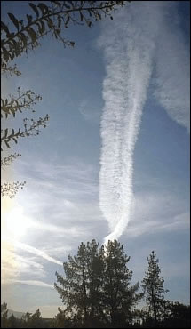
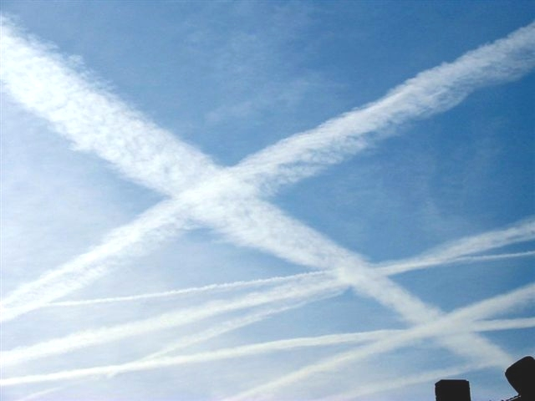
Project Cloverleaf
(aka “The Shield Project”): 1994-present. Global covert military (?) project, coordinated effort to block (scatter) sunlight, involves military and commercial jets spraying of particulates into atmosphere, “global dimming” in order to militarize the atmosphere- so that it behaves as an electrified plasma… in conjunction with addition of directed energy from HAARP and GWEN, probable connection with scalar weapons.

Slide 5
Directed energy: HAARP (High-Frequency Active Auroral Research Project)
- Radio waves, or ELFs (extremely-low frequency waves) can be used to steer hurricanes, the jet stream and weather systems, and generate earthquakes. Such ELFs are created at facilities like HAARP, in Gulkona Alaska. With 360 antennas, HAARP can direct billions of watts of power anywhere around the globe.
- There are 20 smaller “ionospheric heaters” elsewhere, including Puerto Rico, Germany, Russia, Norway, China, etc.

Slide 6
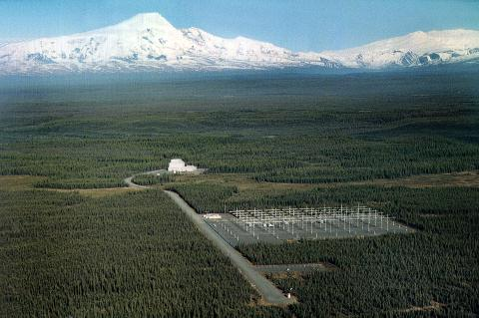
HAARP
HAARP is part of the US military’s non-conventional war program that began in the 1990’s after the collapse of the Soviet Union. Electromagnetic warfare weapons also include scalar weapons, radio frequencies, and micro-wave weapons.
HAARP uses Tesla technology and is part of the RMA (Revolution in Military Affairs).
HAARP is also capable of generating electromagnetic pulses (EMP). It can create a plume of electrically-charged particles that can be exploded when ignited by an electric pulse (EMP). (This technology may be similar or identical to Nicola Tesla’s infamous “death ray.”).
Another possible use of HAARP is to direct ELFs to a fault zone and thereby trigger earthquakes. (See the History Channel’s program “Weather Warfare”.)
Another potential use is “mind control.” HAARP can broadcast electromagnetic energy in the range of human brain waves (0 to 10 hertz). (Author Jerry Smith believes the primary function of HAARP is to bathe the atmosphere in ELFs that are the same frequency as that of the human mind).

Slide 7
Nothing is more terrible than ignorance in action.” Johann Wolfgang von Goethe
Although there is extensive documentation for all of these activities, most citizens are unaware of them.
All of these projects are currently unregulated.
Most citizens have never been given the opportunity to grant or deny their informed consent.
As of 2010, the U.S. Congress and the U.K. House of Commons are proposing to collaborate and coordinate geoengineering activities.*
*2010, Collaboration and Coordination on Geoengineering, U.S. House of Representatives, Committee on Science and Technology and United Kingdom House of Commons Select Committee on Science and Technology.

Slide 8
Documentary Evidence: Policy Implications of Greenhouse Warming: Mitigation, Adaptation, and the Science-Bases (1992, National Academy of Sciences, authorized by Congress, published 2000, 918 pages)
Recommendation: “The most effective global warming mitigation would be a nonregulatory “Manhattan Project” involving the spraying of reflective aerosol compounds into the atmosphere using commercial, military, and private aircraft. This would create a global atmospheric shield which would increase the planet’s albedo (reflectivity) using oxides of aluminum and barium and would introduce ozone-generating chemicals into the atmosphere. Perhaps one of the surprises of this analysis is the relatively low costs at which some of the geoengineering options might be implemented.”

Slide 9
Compare natural clouds (left to right; cirrus, altocumulous, cumulus)

Slide 10
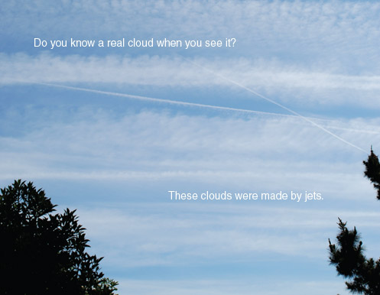
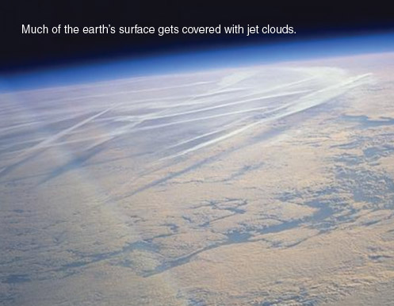
With artificial clouds. These persisting contrails are not natural. The U.S. Air Force admits that “persisting contrails” can last up to 23 hours, cover 4000 km² and change the climate.

Slide 11
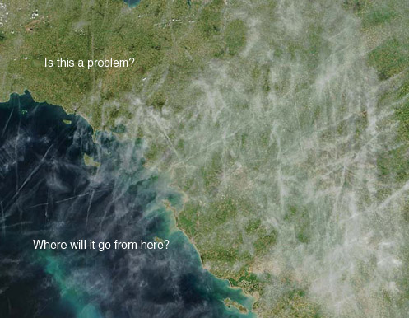
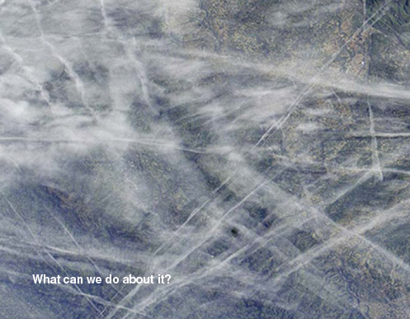
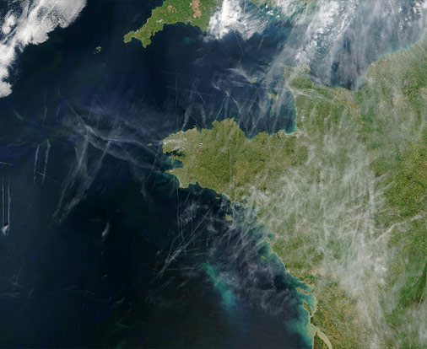
Visual evidence from satellites: These are not normal jet contrails.
What is being added to the atmosphere?
A. Aerosols, particulates, chemicals, directed energy in the form of electromagnetic radiation.

Slide 12
Documentary Evidence: Weather as a Force Multiplier: Owning the Weather in 2025 :
“2025” provides this timeline for use of Enmod technologies in cooperation with the Weather Modification Association:
2000- Introduce ionic mirrors, with sharp increase from 2008
2000-2025- Use chemicals for atmospheric seeding by civilian as well as military aircraft
2004- Create smart clouds through nanno-techology, with sharp increase after 2010.
2005- Introduce “carbon black” dust (soot).

Slide 13
Documentary Evidence: 1997, Global Warming and Ice Ages: Prospects for Physics-Based Modulation of Global Climate, by Edward Teller (Stanford, aka Dr. Strangelove”) and Lowell Wood (Lawrence Livermore National Laboratory, aka “Dr. Evil”), : “
Conclusions:
Potential costs of “Plan A” (mandatory reductions in electricity generation) could be greater than $10o billion/yr.
Their “Plan B:” For $1 billion/yr or less, addition of ”scattering materials” to the stratosphere could reduce incoming solar radiation by 1% and offset a potential doubling of carbon dioxide. Optimal deployment would require addition of several million tons of scattering material to stratosphere/year. About 1% of these aerosols would need to be metals with high electrical conductivity.
This insolation-modulation system could be re-configured to increase insolation- by perhaps 3%- enough to prevent another ice age. Hence, this system could reduce or “eliminate all climate failures” (both global warming and glaciations).

Slide 14
On geoengineering: Dr. Lowell Wood (aka “Dr. Evil”), Lawrence Livermore National Laboratory:
“We’ve engineered every other environment we live in- why not the planet?”
“You don’t have to argue with me, and I don’t have to argue with you, let’s find something more pleasant to talk about, because I’m going to win.”
Rolling Stone article “Can Dr. Evil Save the World?”

Slide 15
1998, Stanford Environmental Law Journal publishes: “Geoengineering: A Climate Manhattan Project” by Jay Michaelson
“Direct manipulation of the climate, whether by iron seeding, particulate scattering, or another mechanism, has the advantage of avoiding or minimizing the problems of absence, difficulty, and economic structure which plague efforts to implement climate change regulation.”

Slide 16
Recent geoengineering documents:
2008, Unilateral Geoengineering,: Non-technical Briefing Notes for a Workshop at the Council on Foreign Relations,
2010, CLIMATE CHANGE: Preliminary Observations on Geoengineering: Science, Federal Efforts, and Governance Issues, General Accounting OfficeGAO-10-546T, 15 pp.
2010, Gordon, B., Chair, Engineering the Climate: Research Needs and Strategies for International Coordination, Committee on Science and Technology, U.S. House of Representatives, 50 pp.
2010, The Regulation of Geoengineering, Fifth Report, U.K. House of Commons. U.K. Royal Society Solar Radiation Management Initiative.
2010, Collaboration and Coordination on Geoengineering, U.S. House of Representatives, Committee on Science and Technology and United Kingdom House of Commons Select Committee on Science and Technology,

Slide 17
Bruce Conway (2003): “Playing God with the atmosphere- the ‘Shield Project’ or ‘Operation Cloverleaf’”
“It was 1998 when I first became aware that the clouds above my home in the San Juan Islands were changing. The formations that I had enjoyed since childhood, often subjects of the looks-like game, were mostly gone. Gone were the giant cotton turtles, faces, mountains and camels.
The clouds of my dreams had been replaced by long, thick, ugly white streaks that bore no resemblance to those of my youth. These new clouds would send out long streamers at right angles to the main bodies, eventurally reaching from horizon to horizon. Layer upon layer of these pseudo clouds would appear, crisscrossing each other in grids until the sky was obscured by thick gray blankets.
In early 1999, I witnessed the makers of these fake clouds and got a look at some of the vehicles responsible for creating them…. I looked up to see a mysterious white tanker plane (C-130) banking steeply, pulling a tight donught in the air, as theick white streamers exuded from the wings. The plane, like those used to refeul others in mid-flight, had just flown over our island at low altitude.
Over my home in the San Juan Islands, chemtrail spraying is a daily occurrence… By the end of the day there is usually a heavy, opaque cover of man-made clouds.”

Slide 18
Two basic geoengineering approaches: 1) Remove carbon dioxide from atmosphere (a total waste of money) since carbon dioxide stimulates life and does not drive temperature) 2) Reduce incoming solar radiation (solar radiation management) via scattering or blocking sunlight

Slide 19
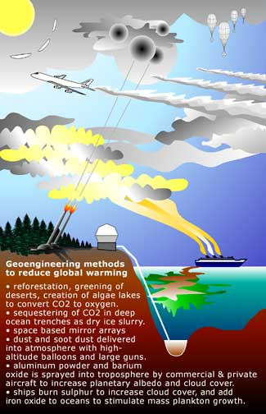
Geoengineering projects and proposals

Slide 20
Two basic geoengineering methods: 1) Remove carbon dioxide from atmosphere-
(expensive and foolish because carbon dioxide is not a pollutant but rather the basis of all life and it does not drive temperature, but rather follows temperature changes as ocean warms and cools naturally)
A) fertilize the oceans with iron filings to promote growth of phytoplankton that absorb carbon dioxide
B) install vast number of funnels in the ocean to draw nutrient-rich cold water to encourage algal blooms that suck carbon dioxide from the air and move it to the deep ocean.
C) build thousands of “sodium trees”
D) carbon sequestration

Slide 21
2) Proposed Sun-blocking Methods (mimicking effects of volcanic eruptions)
Solar Radiation Management- designed to reflect incoming solar radiation, i.e., increase planetary albedo.
A) add small reflective particles (sulfur dioxide, aluminum oxide dust, etc.) to stratosphere, 10-15 km up, to increase planetary albedo and reflect solar radiation.* Could use fleets of high-flying aircraft, naval guns, rockets, hot air balloons or blimps. Estimated costs for 40-yr project: $400 million to $100 billion/year.
(Currently atmosphere reflects about 23% of insolation, an extra 2% would cool planet and supposedly offset doubling of CO2.
B) Cloud seeding to increase low-altitude stratocumulus cloud cover.
D) About 1500 specially designed unmanned ships send up plumes of water vapor that increase cloud cover.
D) Convert dark-colored forests into light-colored grasslands.
E) Mandate whitening of city rooftops and roads.

Slide 22
All of these geoengineering strategies involve great uncertainty and carry significant risks to health of humans and biosphere.
On the grounds of “national security,” however, many of these projects are being conducted today without the knowledge or informed consent of the public.*
*Law 95-79, Title VIII, Sec. 808 (July 30, 1977). It is illegal to perform experiments on people without their informed consent.

Slide 23
Environmental Warfare: The ultimate weapon of mass destruction:
President Lyndon Baines Johnson, as quoted in Lyndon Johnson, Master of the Senate:
"Control of space means control of the world. From space, the masters of infinity would have the power to control the earth's weather, to cause drought and flood, to change the tides and raise the levels of the sea, to divert the Gulf Stream and change temperature climates to frigid.”

Slide 24
Climate engineer Dr. David Keith (University of Calgary):
“The fact is that with the right technology it may be cheap enough, through engineering the stratosphere, that literally individual human beings may have the wealth necessary to introduce an ice age.”
Note: Climate changes naturally on many different time scales. Historically, warming cycles are beneficial for humans and other life forms whereas colder climates are accompanied by shorter growing seasons, shorter life spans, more disease, die-off of species, etc.

Slide 25
Recent headlines
2009 TIME magazine article: “Geoengineering may be the only way to prevent the climate from “collapsing.”
Obama’s Science Czar, John Holdren, in a 2010 interview, compared global warming to being “in a car with bad brakes driving toward a cliff in the fog.”
Therefore, Holdren concludes: “(Geoengineering or Plan B) has got to be looked at. We don’t have the option of taking any approach off the table.”
Caviat: In his 1973 text, Ecosystems, co-authored with Paul and Anne Erlich, Holdren calls for compulsory population control measures, including forced abortion, mass sterilization, and implementation of a “planetary regime” to control the global economy, natural resources, and population. “The first step necessarily involves partial surrender of sovereignty to an international organization.”

Slide 26
Official definition of “Geoengineering:”
“Deliberate, large-scale manipulation of the planetary environment to counteract anthropogenic climate change.”
Royal Society, 2009, Geoengineering the Climate: Science, Governance, and Uncertainty
In this Orwellian distortion of reality, geoengineering is advanced as a solution to a problem that does not exist.
The official rationale for geoengineering comes from the disproven hypothesis that humans are negatively impacting earth’s climate by burning fossil fuels, that carbon dioxide is a pollutant that drives temperatures, and that humans can and should “fix the climate,” which is perhaps the most complex natural system of all.
See my article “Disproofs of Man-Caused Global Warming” on my website http://www.naturalclimatechange.us

Slide 27
“Global Warming, now “Climate Change” or “Climate Disruption” is the official cover story for geoengineering.
On the man-caused global warming fraud:
Ed Ring: It will be remembered as the greatest mass delusion in the history of the world- that carbon dioxide, the life of plants, was considered for a time to be a deadly poison.
Dr. Timothy Ball (Slaying the Sky Dragon: Death of the Greenhouse Gas Theory) refers to global warming as a “massive deception.”
Professor Robert M. Carter (Climate: The Counter-Consensus”): AGW is “the greatest self-organized scientific and political conspiracy that the world has ever seen.” Future generations will regard this as a period of “collective insanity.”

Slide 28
My own work:
Karlstrom, E.T., 1990 and 1991 scientific journal articles: Relict soils and periglacial features in the Glacier Park area indicate average annual temperatures fluctuated by at least 18 C (about 29 to 32 degrees F) over the past 1 million yr.
This temperature range is about 30 times greater than the 1 degree F warming claimed for the 20th century. Therefore, AGW is no big deal and well within the range of natural climate variability.
Also check my www.naturalclimatechange.us website, where I post:
80 page open letter to policy makers, etc.: “Disproofs of the hypothesis of AGW (anthropogenic global warming): And proofs that AGW is a fraud.”

Slide 29
On Man-Caused Global Warming: Paul Johnson:
“The idea that human beings have changed and are changing the basic climate system of the Earth through their industrial activities and burning of fossil fuels- the essence of the Green’s theory of global warming- has about as much basis in science as Marxism and Freudianism. Global warming, like Marxism, is a political theory of actions, demanding compliance with its rules.
Marxism, Freudianism, global warming. These are proof- of which history offers so many examples- that people can be suckers on a grand scale. To their fanatical followers they are a substitute for religion. Global warming, in particular, is a creed, a faith, a dogma that has little to do with science. If people are in need of religion, why don’t they just turn to the genuine article?”

Slide 30
Proposed political solutions to the non-problem of AGW:
Plan A- Kyoto protocol-style rollback of energy supplies. These schemes derive from and would strengthen United Nations. “Global problems require global solutions:” (British P.M., Gordon Brown). They would also cost trillions and needlessly cripple first world economies.
Plan B- geoengineering - which has a nearly 70 year history- mostly unknown to the public.
“I’m not sure which is more arrogant- To say we caused (global warming) or that we can fix it.”
Meteorologist Mark Nolan

Slide 31
A Better Idea: A useful “Plan B” proposed by Professor Carter (Climate: The Counter-Consensus):
Utilize our newly acquired understanding of the rate and magnitude of climate change to develop strategies to adapt to future changes. (Historically and pre-historically, cold periods are much more devastating than warm periods. To be afraid of warming is just plain ignorant, when natural warm periods have been intervals of prosperity, longer life-spans, increased agricultural production, etc.)

Slide 32
Former Secretary of Defense William Cohen (1997), at counterterrorism conference sponsored by former Senator Sam Nunn.
"Others are engaging even in an eco-type of terrorism whereby they can alter the climate, set off earthquakes, volcanoes remotely through the use of electromagnetic waves… So there are plenty of ingenious minds out there that are at work finding ways in which they can wreak terror upon other nations…It's real, and that's the reason why we have to intensify our efforts."

Slide 33
NASA admits man-made cirrus clouds trap heat in atmosphere.
A Smoke Angel from Airplane Flares released by a C-17 Globemaster III Air Force jet over the Atlantic Ocean.

Slide 34
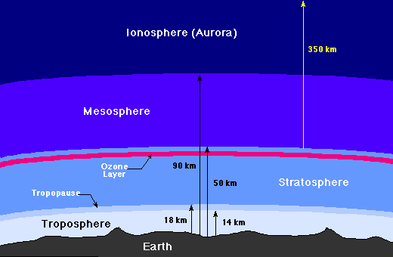
Layers of the atmosphere

Slide 35
Brief history of geoengineering/weather modification/weather warfare:
1943- First operational use of chaff (aluminum strips cut to ¼ of radar’s wavelength) to disable radar during England’s bombing of Hamburg, Germany
1946- G.E.’s Vincent Schaefer dropped 6 lbs. of dry ice into a cold cloud causing “explosive growth” of cloud
1949- Project Cirrus: Silver iodide is used to seed clouds in New Mexico. It rained about 320 billion gallons over half of New Mexico.
1950- Weather Modification Association formed
1952- UK’s Operation Cumulus: Royal Air Force covertly seeded clouds over Devon, England. Flooding caused 35 deaths and destroyed bridges, landscapes.
1962-1983- Project Stormfury: US scientists weakened hurricanes, reducing winds by 30% with cloud-seeding from aircraft.
1966-1972- Operation Popeye: U.S. military seeded clouds over Ho Chi Minh Trail to wash out North Vietnamese supply routes. First successful use of weather warfare

Slide 36
History (continued)
Joint U.S.-Soviet projects
Project POLEX, Polar Experiment of the Global Atmospheric Research Program (attempts to melt polar ice cap).
Project AIDJEX, Arctic Ice Dynamics Joint Experiment
Project Nile Blue, changing of Arctic pack ice
Project Climate Dynamics, changing Arctic pack ice
1970’s. Soviet woodpecker system: ELF waves at about 10 Hz using Tesla transmitters produced scalar grid over the US. Soviets could move the jet stream and create long-term weather blocks.
1986. Soviet Air Force diverted Chernobyl fallout from reaching Moscow by seeding clouds. Belarus was hit instead.
2008. Chinese government used 1,104 cloud–seeding missiles to remove threat of rain ahead of Olympic opening ceremony in Beijing.

Slide 37
Geoengineering (aka weather/environmental warfare): policy paper trail:
1992, Policy Implications of Greenhouse Warming: Mitigation, Adaptation, and the Science Base, National Academy of Sciences, 918 pp.
1996: Using the Weather as a Force Multiplier: Owning the Weather in 2025, US Air Force.
1997, Teller and Wood, Global Warming and the Ice Ages: I. Prospects for Physics-Based Modulation of Global Change
1997, Vision for 2020, United States Space Command.
1998, Geoengineering: A Climate Change Manhattan Project, Jay Michaelson, Stanford University.
2001, IPCC Third Assessment Report calls for using geoengineeering to “mitigate” global warming.
2000, Joint Vision 2020: America’s Military- Preparing for Tomorrow, Directorate for Strategic Plans and Policy (J-5) 76 pp.- calls for “Full Spectrum Dominance” of Space by U.S. military

Slide 38
Geoengineering paper trail (cont.)
2000, Aviation and the Environment: Aviation’s Effects on the Global Atmosphere Are Potentially Significant and Expected to Grow Research Service, General Accounting Office.
2008, Unilateral Geoengineering,: Non-technical Briefing Notes for a Workshop at the Council on Foreign Relations.
2010, Geoengineereing: Governance and Technology Policy, (CRS Report for Congress, 7-5700).
2010, CLIMATE CHANGE: Preliminary Observations on Geoengineering: Science, Federal Efforts, and Governance Issues, General Accounting OfficeGAO-10-546T, 15 pp.
2010, Gordon, B., Chair, Engineering the Climate: Research Needs and Strategies for International Coordination, Committee on Science and Technology, U.S. House of Representatives, 50 pp.
2010, The Regulation of Geoengineering, Fifth Report, U.K. House of Commons. U.K. Royal Society Solar Radiation Management Initiative.
2010, Collaboration and Coordination on Geoengineering, U.S. House of Representatives, Committee on Science and Technology and United Kingdom House of Commons Select Committee on Science and Technology.

Slide 39
Pertinent Patents
1967- System and Method for Irradiation of Planet Surface Areas for weather control, illumination, heating, etc. from orbiting planar satellite reflecting sunlight.
1975- U.S Navy CONTRAIL GENERATOR PATENT: “Powder Contrail” having maximum radiation scattering ability for a given weight of material. The seeding material consists of 85% metallic particles and 15% colloidal silica gel in order to produce a stable contrail that has a residence period of 1 up to 2 weeks.”
1987- Bernard Eastlund and HAARP patent: Directed energy weapons of more than a billion watts can be used to “alter the upper atmosphere wind patterns using plumes of atmospheric particles as a lens or focusing device” to disturb weather thousands of miles away.
1991- Hughes Aircraft Welsbach Seeding Patent “contains 18 claims to reduce global warming through stratospheric seeding with aluminum oxide… thorium oxide.. And refractory Welsbach material…” Calls for using aluminum particles of 10 to 100 micron size.
1994- method for precipitating atmospheric water by means of multi-component aerosols, including silver iodide, alkali metals, lead, copper, barium, ammonia, barium chromate, etc.
2009- “modification of cirrus clouds to reduce global warming” proposed two methods of delivery for this same proportion of metallics to silica (85% vs. 15%) and the same staying power of one to two weeks.

Slide 40
Pertinent Laws: HR 2977- “Space Preservation Act” of 2001 (107th Congress): Not passed.
Would have banned the US from using:
chemtrails, plasma, electromagnetic radiation, extremely low frequency (ELF) or ultra-low frequency (ULF) energy radiation, electromagnetic, sonic, laser weapons systems, psychotronic or other energies,
strategic, theatre, tactical or extraterrestrial weapons,
exotic weapons systems, including weapons designed to damage space or natural ecosystems (such as the ionosphere and upper atmosphere) or climate, weather, and tectonic systems with the purpose of inducing damage or destruction upon a target population or region on earth or in space (environmental warfare).
space-based weapons, including missiles, energy weapons, subatomic particle beams,,
information war, mood management, mind control,
chemical or biological agents, electronic, psychotronic, or information weapons

Slide 41
Other pertinent bills not passed.
2005- S. 517: Bill to Establish Weather Modification Operations Research Board, and for other purposes (Sen. Kay Hutchison, R-TX)
2009- S. 601: Weather Mitigation Research and Development Policy Authorization Act of 2009 (Sen. Kay Hutchison, R-TX)

Slide 42
Pertinent Treaties:
1977 UN Convention on the Prohibition of Military or Any Other Hostile Use of Environmental Modification Technique” (ENMOD) forbids signatory nations from military or other hostile use of weather-modification that could result in widespread, long-lasting or severe effects.
2010 UN Convention on Biodiversity imposes a moratorium on geoengineering projects such as vast cloud-seeding schemes to fight climate change, artificial volcanoes, ocean fertilization, spraying sea-water into the atmosphere to whiten clouds, place trillions of solar reflectors in space. 195 nations agree. The US abstains.
Pat Mooney, of ETC Group: “It is absolutely inappropriate for a handful of governments in industrialized countries to make a decision to try geoengineering without he approval of all the world’s support.”.

Slide 43
Weather as a Force Multiplier: Owning the Weather in 2025

Slide 44
“2025” provides timeline for use of Enmod technologies in cooperation with the Weather Modification Association:
2000- Introduce ionic mirrors, with sharp increase from 2008
2000-2025- Use chemicals for atmospheric seeding by civilian as well as military aircraft
2004- Create smart clouds through nanno-techology, with sharp increase after 2010.
2005- Introduce “carbon black” dust (soot).

Slide 45
2025: Technology advancements in five major areas are necessary for an integrated weather-modification capability:
1) advanced nonlinear modeling techniques *
2) computational capacity *
3) information gathering and transmission*
4) a global sensor array
5) weather intervention techniques
(* = now being carried out by funding for research into “anthropogenic global warming”)

Slide 46
Operational Capabilities Matrix of “2025”
Precipitation enhancement or avoidance to degrade or improve lines of communication, visibility, morale
Storm enhancement and modification to deny operations or modify battlespace environment
Precipitation denial (induce drought and deny fresh water)
Create or remove fog to increase or reduce concealment
Change “space weather” (i.e. ionosphere) to disrupt or improve communications/radar or destroy space assets

Slide 47
Some pertinent quotes: Zbigniew Brzenzinski in Between Two Ages: America’s Role in the Technetronic Age, 1970:
“Technology will make available, to the leaders of major nations, techniques for conducting secret warfare, of which only a bare minimum of the security forces need be appraised…. Technology of weather modification could be employed to produce prolonged periods of drought or storm.”

Slide 48
A Smoke Angel from Airplane Flares Credit: Russell E. Cooley IV, USAF Looking perhaps a bit like a gigantic owl monster, the cloud pictured above resulted from a series of flares released by an air force jet over the Atlantic Ocean in May. The jet that released the flares, a C-17 Globemaster III, is seen on the right. The flares release smoke and the resulting pattern is sometimes known as a smoke angel. The circular eyes of the above smoke angel are caused by air spiraling off the plane's wings and are known as wingtip vortices.

Slide 49
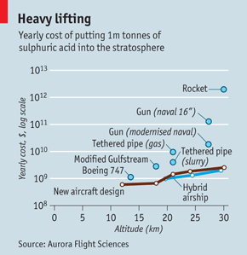
Geoengineering research papers and proposed methods

Slide 50
Brief history of Tesla technology
1886- Nicola Tesla invents alternating current (60-pulse/sec or hertz).
1900- Tesla applies for patent to transmit “electrical energy through the natural mediums.”
1924- Confirmation that radio waves bounce off ionosphere.
1940- Tesla announces “death ray” invention.
1958- Van Allen radiation discovered, 2000+ miles up.
1958- Project Argus. US Navy explodes 3 nuclear bombs in Van Allen Belt.
1958- White House advisor on weather modification says Defense Dept. is studying ways to manipulate charges “of earth and sky, and so affect the weather.”
1960- Series of weather disasters begins.
1961? Copper needles dumped into ionosphere as “telecommunications shield.”

Slide 51
Brief history of Tesla technology (cont.)
1961- Scientists propose artificial ion cloud experiments. In 1960’s, dumping of barium powder etc. from satellites/rockets began.
1961-62- USA and Soviets blast many EMPs in atmosphere, 300 megatons of nuclear devices deplete ozone layer by about 4%.
1962. Launch of Canadian satellites and start of stimulating plasma resonances by antennas within the space plasma.
1966- Gordon J.F. MacDonald publishes military ideas on environmental engineering (“How to Wreck the Environment.”)
1960’s- In Wisconsin, US Navy Project Sanguine lays ELF antennae.
1968- Moscow scientists tell the West that Soviets discovered which magnetic field frequencies help human mental and physiological functions and which do harm.

Slide 52
Brief history of Tesla technology (cont.)
1972- First reports on “ionospheric heater” experiments with high frequency radio waves, at Arecibo, Puerto Rico. 100-megawatt heater in Norway built later in decade. These can change conductivity of auroral ionosphere.
1973- Recommendation for study of Project Sanguine’s biological effects denied by Navy.
1974- United Nations General Assembly bans environmental warfare.
1974- High-frequency experiments at Platesville, CO, Arecibo, Puerto Rico, and Armidale, New South Wales heat “bottom side of ionosphere.”
Experiments airglow brightened by hitting oxygen atoms in ionosphere with accelerated electrons.
1975- Stanford professor Robert Helliwell reports that VLF from power lines is altering ionosphere.
US Senator Gaylord Nelson forces the Navy to release research showing that ELF transmissions can alter human blood chemistry.

Slide 53
Brief history of Tesla technology (cont.)
1975- Pell Senate Subcommittee urges that weather and climate modification work be overseen by civilian agency answerable to US Congress. It didn’t happen.
1975- Soviets begin pulsing “Woodpecker” ELF waves, at key brainwave rhythms . Eugene, Oregon, was one area particularly affected.
1976- Drs. Susan Bawin and W. Ross Adey show nerve cells affected by ELF fields.
1979- Launch of NASA’s third High-Energy Astrophysical Observatory causes large-scale, artificially-induced depletion in the ionosphere. Plasma hole caused by “rapid chemical processes” between rocket exhaust and the ozone layer.” “Ionosphere was significantly depleted over a horizontal distance of 300 km for some hours.”
1985- Bernard Eastlund applies for patent: “Method and Apparatus for Altering a Region in the Earth’s Atmosphere, Ionosphere, and/or Magnetosphere” (first of 3 Eastlund patents assigned to ARCO Power Technologies, Inc.)
1986- U.S. Navy Project Henhouse duplicates Delgado (Madrid) experiment- very low-level, very-low-frequency pulsed magnetic fields harm chick embryos.
1980’s – US begins network of Ground Wave Emergency Network (GWEN) towers, each to generate Very Low Frequency (VLF) waves for defense purposes.

Slide 54
Brief history of Tesla technology (cont.)
1987-1992- Other APTI scientists build on Eastlund patents for development of new weapons capabilities.
1994- Military contractor E-Systems buys APTI, holder of Eastlund patents and contract to build biggest ionospheric heater in the world (HAARP).
1994-Congress freezes funding on HAARP until planners increase emphasis on earth-penetrating tomography (EPT) uses, for nuclear counter-proliferation efforts.
1995- Raytheon buys E-Systems and old APTI patents. The technology is now hidden among thousands of patents within one of the largest defense contractor portfolios.
1995- Congress budgets $10 million for 1996 under “nuclear counter-rproliferation” efforts for HAARP project.
1994-96- Testing of first-stage HAARP (High Frequency Active Research Project). Equipment continues, although funding was frozen.
1996- HAARP planners to test the earth-penetrating tomography applications by modulating the electro-jet at Extremely Low Frequencies.
1998: Projected date for fully-operational HAARP system.

Slide 55
A pertinent quote re: “the science is settled” mantra by Michael Crichton, 2003
“I regard consensus science as an extremely pernicious development that ought to be stopped cold in its tracks. Historically, the claim of consensus has been the first refuge of scoundrels; it is a way to avoid debate by claiming the matter is already settled. Whenever you hear the consensus of scientists agrees on something or other, reach for your wallet, because you are being had.
Let’s be clear, the work of science has nothing whatever to do with consensus. Consensus is the business of politics. Science, on the contrary, requires only one investigator who happens to be right, which means that he or she has results that are verifiable by reference to the real world. In science consensus is irrelevant. What is relevant is reproducible results. The greatest scientists in history are great precisely because they broke with consensus.
There is no such thing as consensus science. If it’s consensus, it isn’t science. If it’s science, it isn’t consensus. Period.”

Slide 56
Ed Ring on AGW, 2008:
“What historians will definitely wonder about in future centuries is how deeply flawed logic, obscured by shrewd and unrelenting propaganda, actually enabled a coalition of powerful special interests to convince nearly everyone in the world that carbon dioxide from human industry was a dangerous, planet-destroying toxin.
It will be remembered as the greatest mass delusion in the history of the world- that carbon dioxide, the life of plants, was considered for a time to be a deadly poison.”

Slide 57
Vaclav Klaus, President, Czech Republic, on AGW:
“As someone who lived under communism for most of my life I feel obliged to say that the biggest threat to freedom, democracy, the market economy and prosperity at the beginning of the 21st century is not communism or its various softer variants. Communism (has been) replaced by the threat of ambitious environmentalism…
The environmentalists consider their ideas and arguments to be an undisputable truth and use sophisticated methods of media manipulation and PR campaigns to exert pressure on policymakers to achieve their goals. Their argumentation is based on the spreading of fear and panic by declaring the future of the world to be under serious threat. In such an atmosphere they continue pushing policymakers to adopt illiberal measures, impose arbitrary limits, regulations, prohibitions, and restrictions on everyday human activities and make people subject to omnipotent bureaucratic decision-making….
Manmade climate change has become one of the most dangerous arguments aimed at distorting human efforts and public policies in the world.”

Slide 58
Professor Robert M. Carter (who also spoke at the Commonwealth Club) on the AGW fraud (Climate: The Counter-Consensus):
“The ABC, Australian Broadcast Company, provides a “greenhouse gas calculator” where, by answering questions about their lifestyle, a primary school child is encouraged to work out the amount of carbon dioxide that their activities produce, and thereby- and I’m not making this up- “to find out what age that you should die at so you don’t use more than your fair share of Earth’s resources.”

Slide 59
The insertion of propaganda/P.R. firms into the global warming issue (from Carter’s Climate: The Counter-Consensus):
“The task of climate change agencies is not to persuade by rational argument… Instead, we need to work in a more shrewd and contemporary way, using subtle techniques of engagement…. The “facts” need to be treated as being so taken-for-granted that they need not be spoken.
Ultimately, positive climate behaviors need to be approached in the same way as marketeers approach acts of buying and consuming… It amounts to treating climate-friendly activity as a brand that can be sold. This is, we believe, the route to mass behaviour change.”
G. Ereaut and N. Segnit, 2006, Institute for Public Policy Research, London, England

Slide 60
H.L. Mencken:
“The whole aim of practical politics is to keep the populace alarmed (and hence clamorous to be led to safety) by menacing it with an endless series of hobgoblins, all of them imaginary.”

Slide 61
My Conclusions:
1) Man-caused global warming is a propaganda fraud disproven by reality and the evidence. It serves several purposes, among them, the rational for implementing Plan A-type “remedies” (cutback “carbon emissions”) and Plan B-type “remedies” (geoengineering).
2) Though officially denied, geoengineering is our current reality. It is being implemented by governments, militaries, private corporations, and wealthy individuals. It has a long (>60 yr) history. It includes many local and large-scale weather modification projects as well as weather and environmental warfare. These projects are currently unregulated and potentially threaten all life on earth. We citizens have not been informed or given our informed consent.
3) There needs to be full disclosure of geoengineering operations to the citizens of the United States and other countries.
4) National sovereignties should not be surrendered to the United Nations or some other international body with totalitarian aims.

